Slide 1

Lecture 7 Fourier Series of Discrete-time Signals
School of Computer Engineering and Science
Shanghai University
Instructor: Jianjia Wang, Shengyu Duan

Slide 2
Outline: Lecture 7: Fourier Series of Discrete-time Signals
Discrete Time Fourier Series
Fourier Series Representation
Determination of Fourier Series Coefficient
Fourier Series Properties
Application Example
System Characterization
Filtering

Slide 3
Outline: Lecture 7: Fourier Series of Discrete-time Signals
Discrete Time Fourier Series
Fourier Series Representation
Determination of Fourier Series Coefficient
Fourier Series Properties
Application Example
System Characterization
Filtering

Slide 4
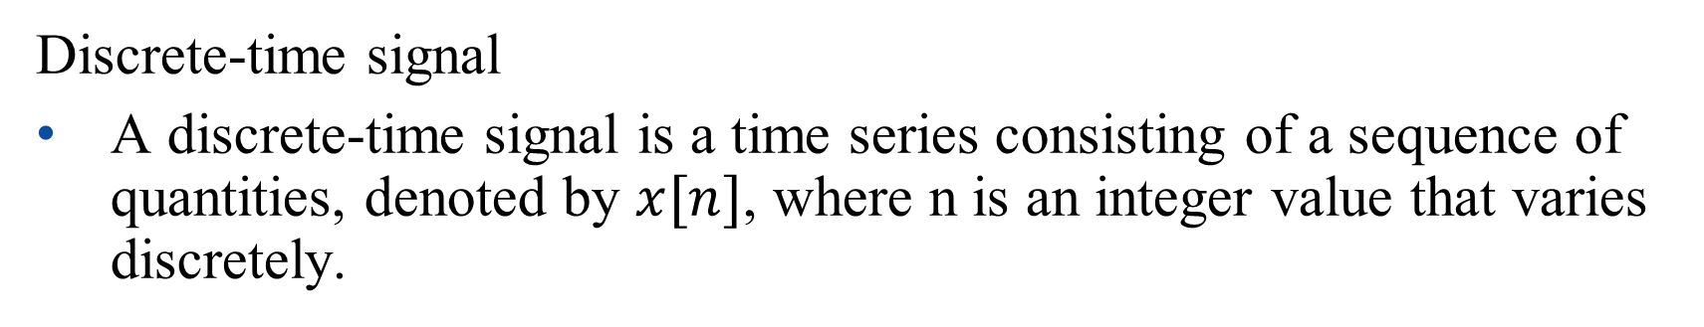
Discrete Time Fourier Series Representation
Discrete-time signal
A discrete-time signal is a time series consisting of a sequence of quantities, denoted by $x[n]$, where n is an integer value that varies discretely.
x[n]
n

Slide 5
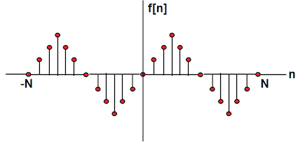
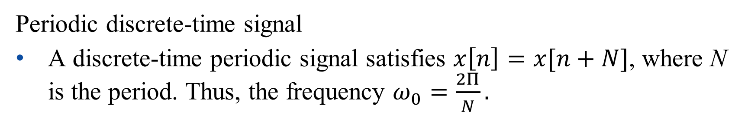
Discrete Time Fourier Series Representation
Periodic discrete-time signal
A discrete-time periodic signal satisfies $x\left[n\right]=x[n+N]$, where N is the period. Thus, the frequency $ω_{0}=\frac{2Π}{N}.$

Slide 6
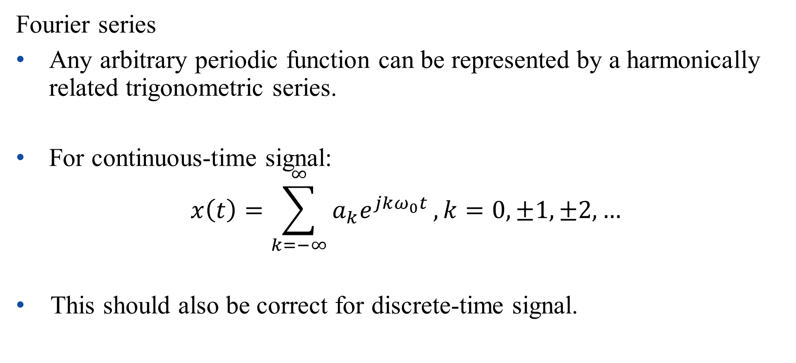
Discrete Time Fourier Series Representation
Fourier series
Any arbitrary periodic function can be represented by a harmonically related trigonometric series.
For continuous-time signal:
$$x\left(t\right)=\sum_{k=−∞}^{∞}{a_{k}e^{jkω_{0}t}},k=0,±1,±2,…$$
This should also be correct for discrete-time signal.

Slide 7
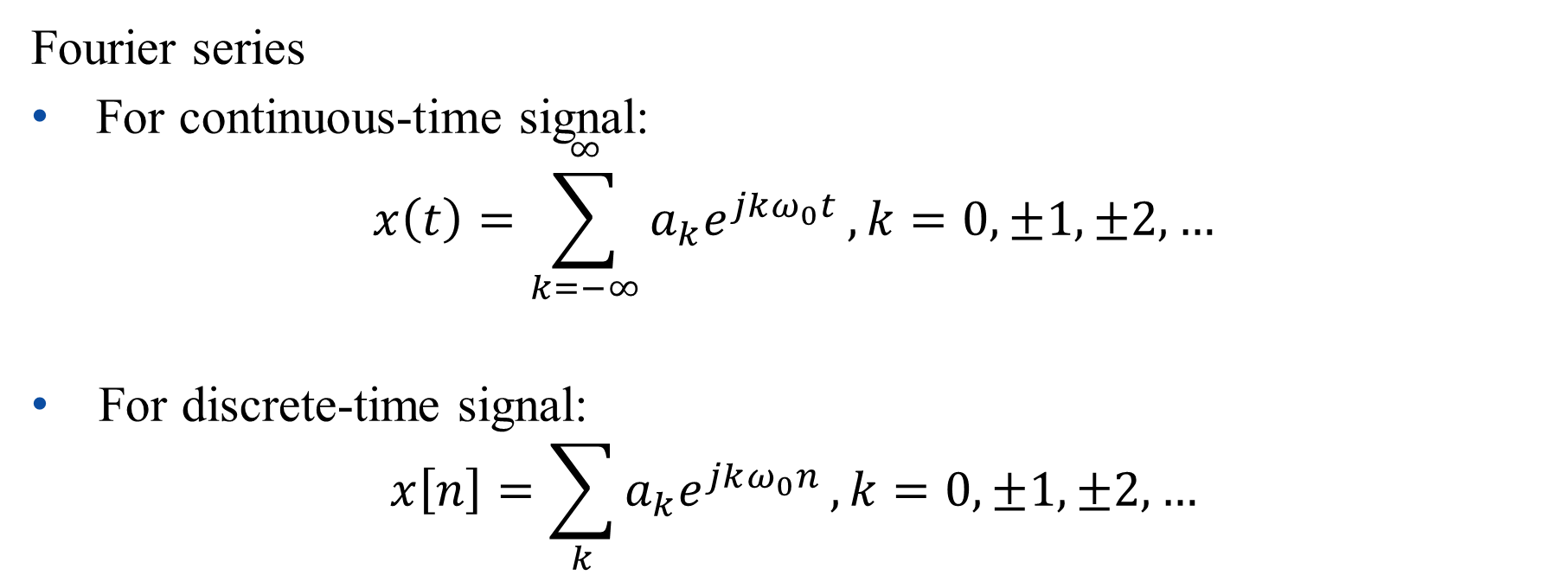
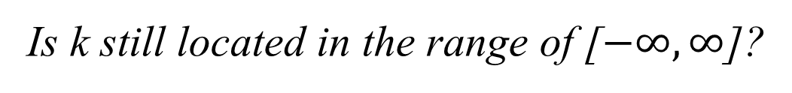
Discrete Time Fourier Series Representation
Fourier series
For continuous-time signal:
$$x\left(t\right)=\sum_{k=−∞}^{∞}{a_{k}e^{jkω_{0}t}},k=0,±1,±2,…$$
For discrete-time signal:
$$x\left[n\right]=\sum_{k}{a_{k}e^{jkω_{0}n}},k=0,±1,±2,…$$
Is k still located in the range of [$−∞, ∞$]?

Slide 8
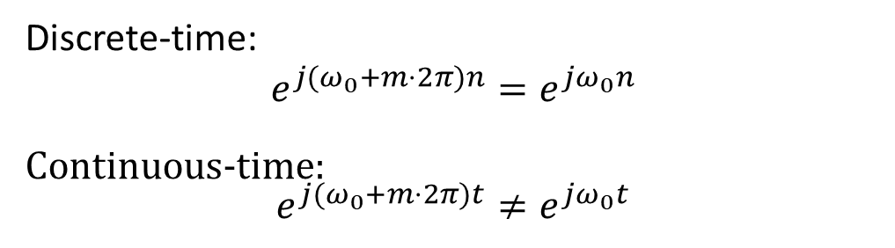
Discrete Time Fourier Series Representation
Important Differences Between Continuous-time and Discrete-time Exponential/Sinusoidal Signals
重要！
For discrete-time, signals with frequencies ω₀ and
ω₀ +m．2π are identical. This is Not true for
continuous-time.
Discrete-time:
$$e^{j(ω_{0}+m⋅2π)n}=e^{jω_{0}n}$$
Continuous-time: $$e^{j(ω_{0}+m⋅2π)t}≠e^{jω_{0}t}$$

Slide 9
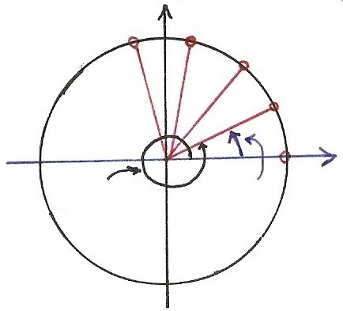










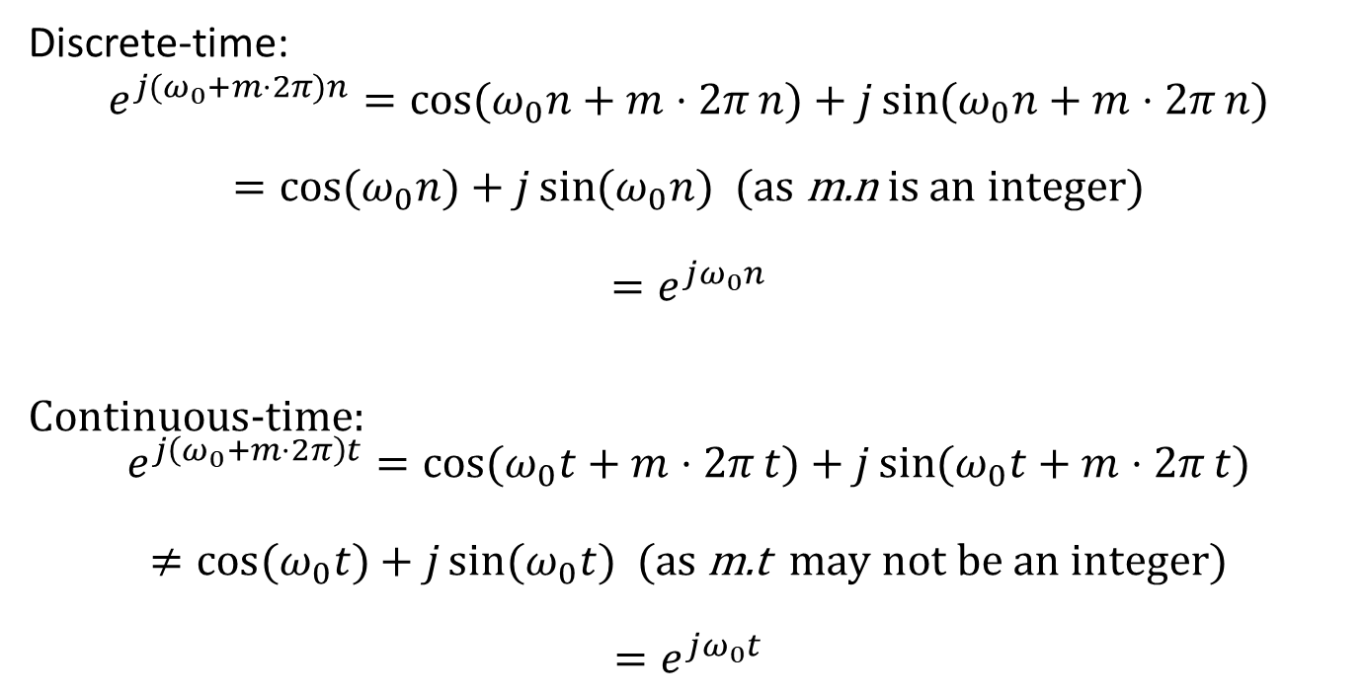
Continuous/Discrete Sinusoidals
重要！
Discrete-time:
$$e^{j(ω_{0}+m⋅2π)n}=\cos{(ω_{0}n+m⋅2π}n)+j\sin{(ω_{0}n+m⋅2π}n)$$
$=\cos{(ω_{0}n})+j\sin{(ω_{0}n})$ (as m.n is an integer)
$$=e^{jω_{0}n}$$
Continuous-time: $$e^{j\left(ω_{0}+m⋅2π\right)t}=\cos{(ω_{0}t+m⋅2π}t)+j\sin{(ω_{0}t+m⋅2π}t)$$
$$≠\cos{(ω_{0}t})+j\sin{(ω_{0}t}) \text{(}\text{as} \text{m}\text{.}\text{t} \text{may} \text{not} \text{be} \text{an} \text{integer}\text{)}$$
$$=e^{jω_{0}t}$$
$$Im$$
$$n=4$$
$$n=3$$
$$n=2$$
$$e^{j[⋅]}$$
$$n=1$$
$$Re$$
$$ω_{0}t$$
$$n=0$$
$${(ω}_{0}+2π)t$$

Slide 10
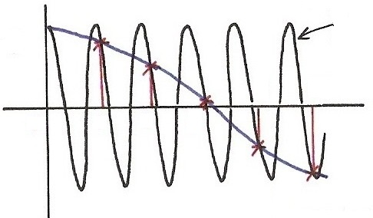
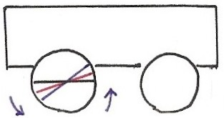










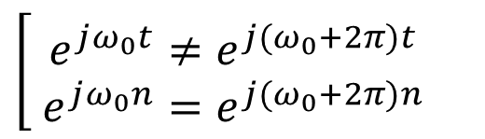



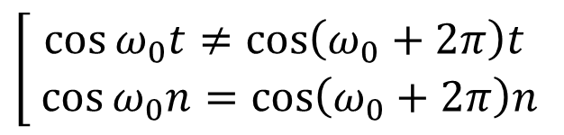



Discrete Time Fourier Series Representation
$$\cos{[\left(ω_{0}+2π\right)t]}$$
$$(t=n)$$
$$\cos{[⋅]}$$
$$\left[\begin{aligned}\cos{ω_{0}t}≠\cos\left(ω_{0}+2π\right)t \\ \cos{ω_{0}n}=\cos\left(ω_{0}+2π\right)n\end{aligned}\right.$$
4
5
$$t,n$$
0
1
2
3
$$\left[\begin{aligned} e^{jω_{0}t}≠e^{j{(ω}_{0}+2π)t} \\ e^{jω_{0}n}=e^{j{(ω}_{0}+2π)n}\end{aligned}\right.$$
$$\cos{[ω_{0}t]}$$
$$(t=n)$$
$$Im$$
$$n=4$$
$$n=3$$
$$n=2$$
$$e^{j[⋅]}$$
$$n=1$$
$$Re$$
$$ω_{0}t$$
$$n=0$$
$${(ω}_{0}+2π)t$$

Slide 11
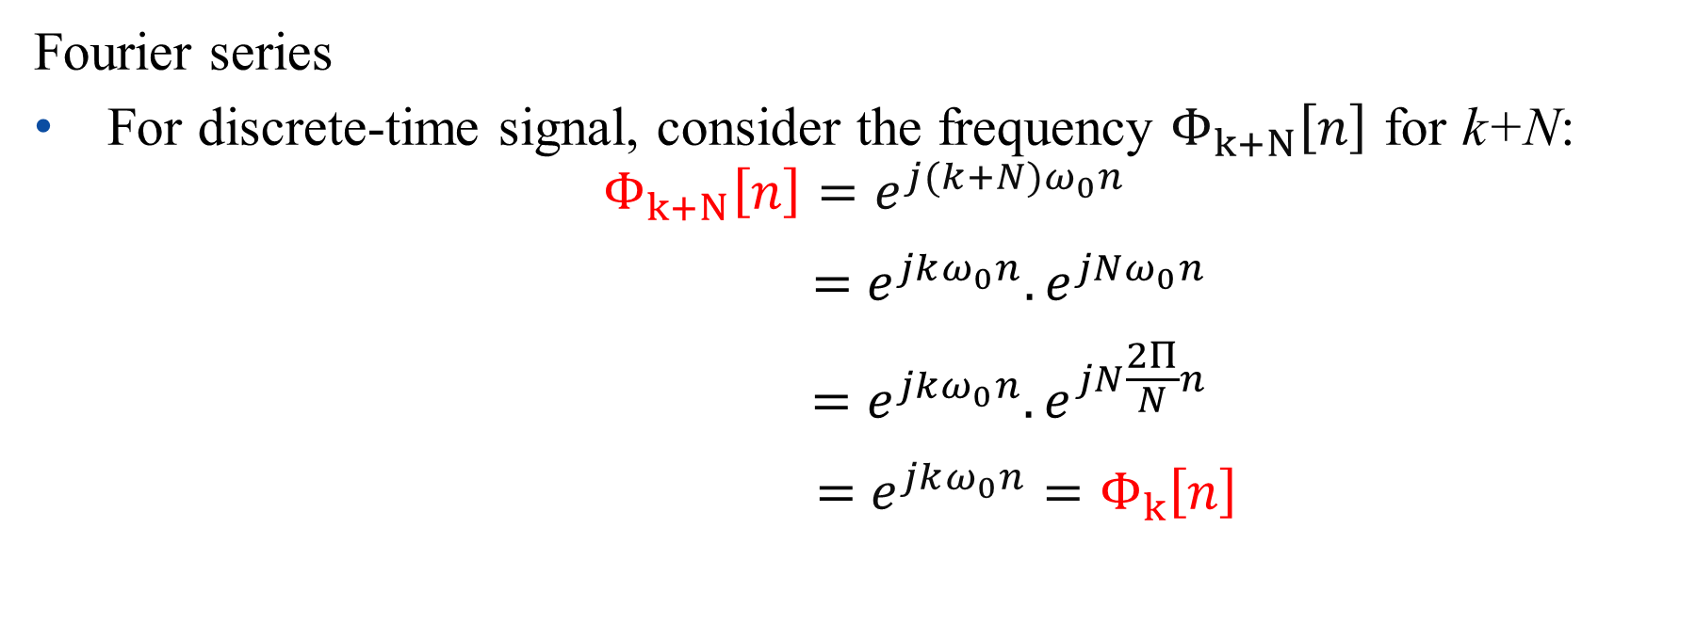
Discrete Time Fourier Series Representation
Fourier series
For discrete-time signal, consider the frequency $Φ_{k+N}\left[n\right]$ for k+N:
$$Φ_{k+N}\left[n\right]=e^{j(k+N)ω_{0}n}$$
$$=e^{jkω_{0}n}.e^{jNω_{0}n}$$
$$=e^{jkω_{0}n}.e^{jN\frac{2Π}{N}n}$$
$$=e^{jkω_{0}n}=Φ_{k}\left[n\right]$$

Slide 12
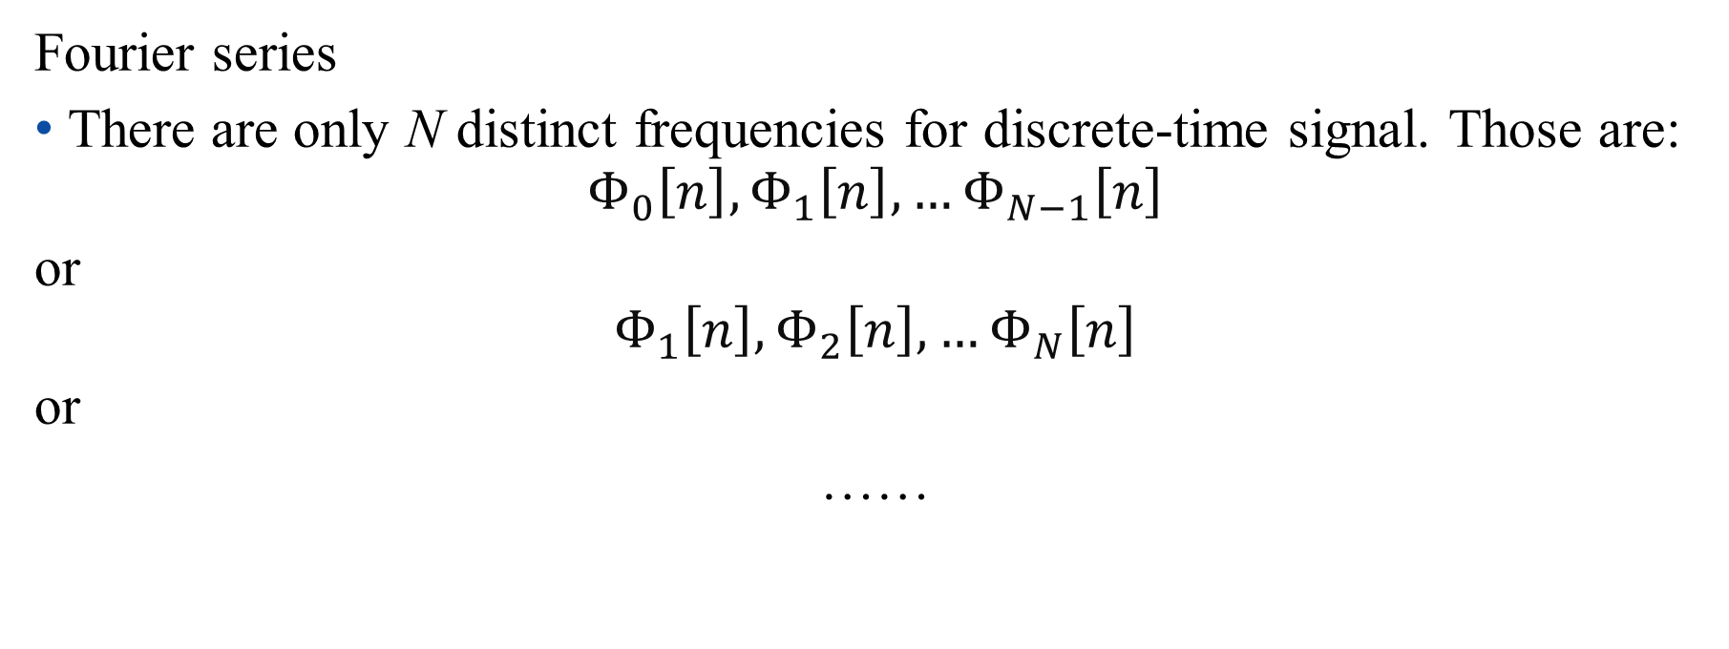
Discrete Time Fourier Series Representation
Fourier series
There are only N distinct frequencies for discrete-time signal. Those are:
$$Φ_{0}\left[n\right],Φ_{1}\left[n\right], …Φ_{N−1}\left[n\right]$$
or
$$Φ_{1}\left[n\right],Φ_{2}\left[n\right], …Φ_{N}\left[n\right]$$
or
……

Slide 13

Discrete Time Fourier Series Representation
Discrete-time Fourier series representation
$$x\left[n\right]=\sum_{k=\left\langle N\right\rangle }{a_{k}e^{jkω_{0}n}}$$
$\left\langle N\right\rangle$ indicates N consecutive integers, e.g., [0, N-1], [1, N], [2, N+1], etc.

Slide 14
Outline: Lecture 7: Fourier Series of Discrete-time Signals
Discrete Time Fourier Series
Fourier Series Representation
Determination of Fourier Series Coefficient
Fourier Series Properties
Application Example
System Characterization
Filtering

Slide 15
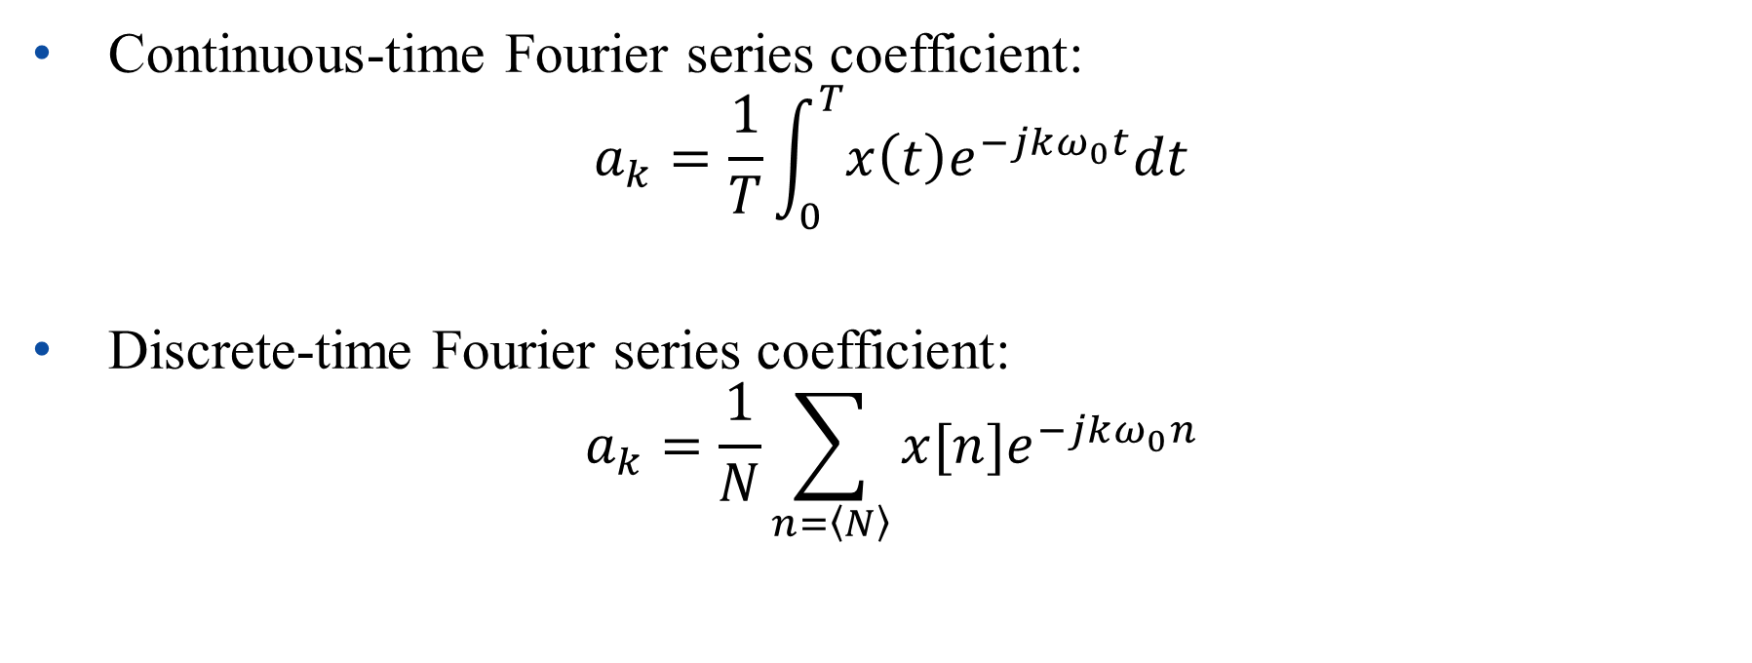
Determination of Fourier Series Coefficient
Continuous-time Fourier series coefficient:
$$a_{k}=\frac{1}{T}\int_{0}^{T}{x\left(t\right)e^{−jkω_{0}t}dt}$$
Discrete-time Fourier series coefficient:
$$a_{k}=\frac{1}{N}\sum_{n=\left\langle N\right\rangle }{x[n]e^{−jkω_{0}n}}$$

Slide 16
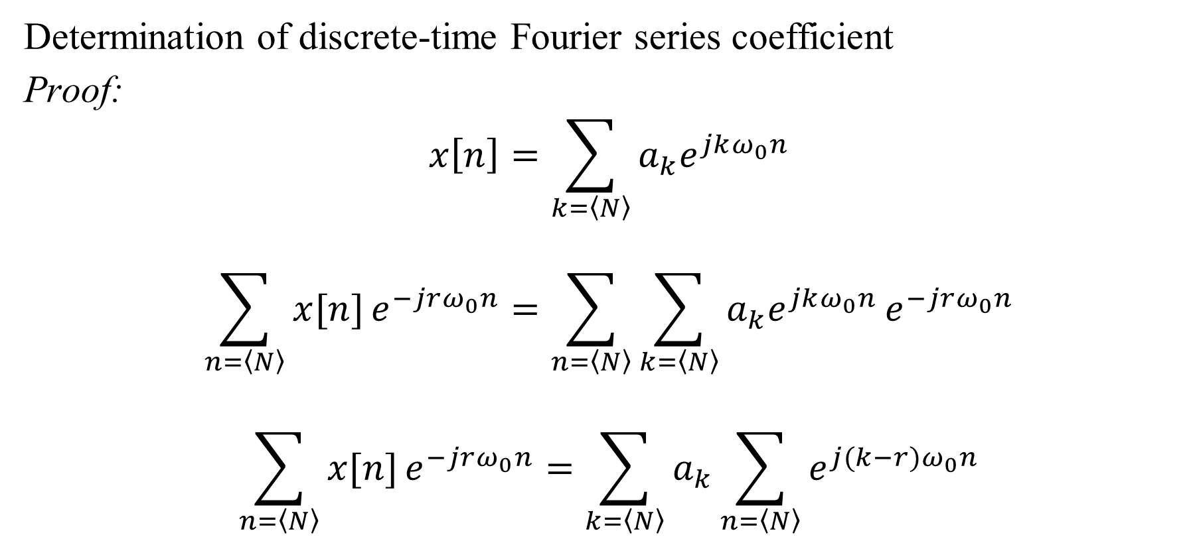
Determination of Fourier Series Coefficient
Determination of discrete-time Fourier series coefficient
Proof:
$$x\left[n\right]=\sum_{k=\left\langle N\right\rangle }{a_{k}e^{jkω_{0}n}}$$
$$\sum_{n=\left\langle N\right\rangle }{x[n]}e^{−jrω_{0}n}=\sum_{n=\left\langle N\right\rangle }{\sum_{k=\left\langle N\right\rangle }{a_{k}e^{jkω_{0}n}}}e^{−jrω_{0}n}$$
$$\sum_{n=\left\langle N\right\rangle }{x[n]}e^{−jrω_{0}n}=\sum_{k=\left\langle N\right\rangle }{a_{k}\sum_{n=\left\langle N\right\rangle }{e^{j(k−r)ω_{0}n}}}$$

Slide 17
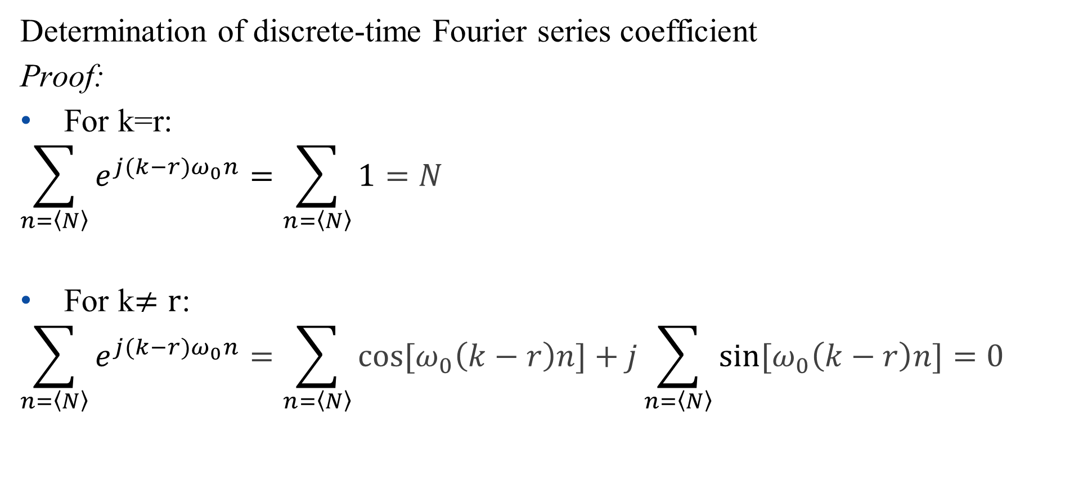
Determination of Fourier Series Coefficient
Determination of discrete-time Fourier series coefficient
Proof:
For k=r:
$$\sum_{n=\left\langle N\right\rangle }{e^{j(k−r)ω_{0}n}}=\sum_{n=\left\langle N\right\rangle }{1}=N$$
For k$≠r$:
$$\sum_{n=\left\langle N\right\rangle }{e^{j(k−r)ω_{0}n}}=\sum_{n=\left\langle N\right\rangle }{cos⁡[ω_{0}\left(k−r\right)n]}+j\sum_{n=\left\langle N\right\rangle }{sin⁡[ω_{0}\left(k−r\right)n]}=0$$

Slide 18
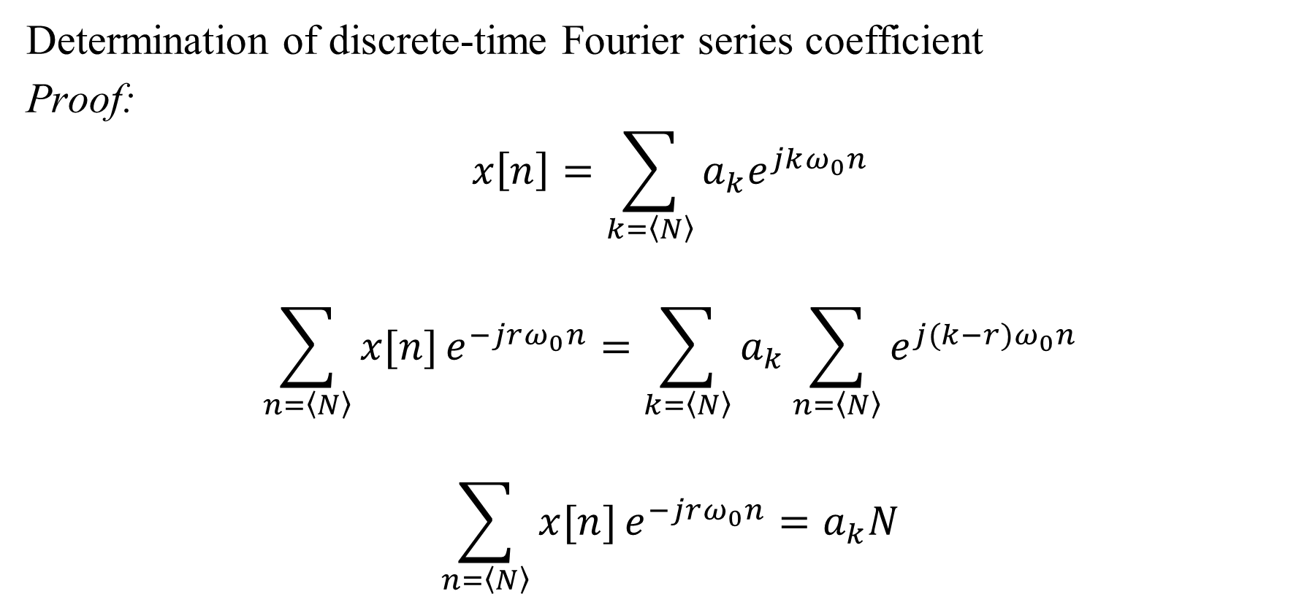
Determination of Fourier Series Coefficient
Determination of discrete-time Fourier series coefficient
Proof:
$$x\left[n\right]=\sum_{k=\left\langle N\right\rangle }{a_{k}e^{jkω_{0}n}}$$
$$\sum_{n=\left\langle N\right\rangle }{x[n]}e^{−jrω_{0}n}=\sum_{k=\left\langle N\right\rangle }{a_{k}\sum_{n=\left\langle N\right\rangle }{e^{j(k−r)ω_{0}n}}}$$
$$\sum_{n=\left\langle N\right\rangle }{x[n]}e^{−jrω_{0}n}=a_{k}N$$

Slide 19
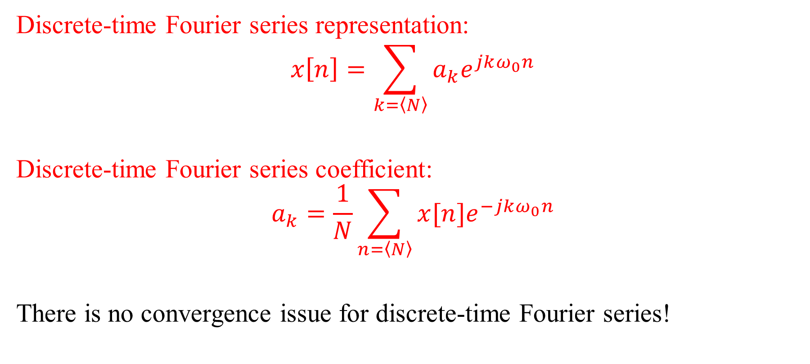
Determination of Fourier Series Coefficient
Discrete-time Fourier series representation:
$$x\left[n\right]=\sum_{k=\left\langle N\right\rangle }{a_{k}e^{jkω_{0}n}}$$
Discrete-time Fourier series coefficient:
$$a_{k}=\frac{1}{N}\sum_{n=\left\langle N\right\rangle }{x[n]e^{−jkω_{0}n}}$$
There is no convergence issue for discrete-time Fourier series!

Slide 20
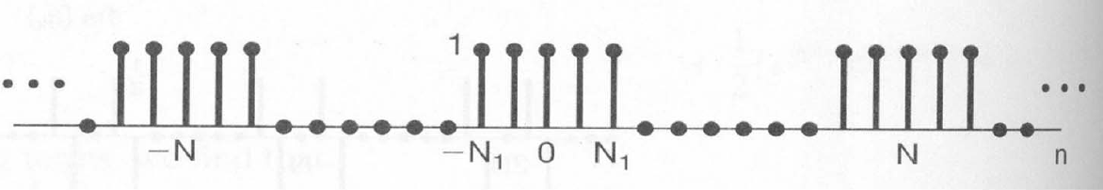

Determination of Fourier Series Coefficient
Example
Find $a_{k}$ for the following discrete-time periodic signal

Slide 21

Determination of Fourier Series Coefficient
Solution
$$a_{k}=\frac{1}{N}\sum_{n=\left\langle N\right\rangle }{x[n]e^{−jkω_{0}n}}=\frac{1}{N}\sum_{n=−N_{1}}^{N_{1}}{e^{−jkω_{0}n}}$$
$$=\frac{1}{N}\frac{e^{jkω_{0}N_{1}}−e^{−jkω_{0}{(N}_{1}+1)}}{1−e^{−jkω_{0}}}=\frac{1}{N}\frac{e^{−jk\frac{ω_{0}}{2}}}{e^{−jk\frac{ω_{0}}{2}}}\frac{e^{jkω_{0}{(N}_{1}+\frac{1}{2})}−e^{−jkω_{0}{(N}_{1}+\frac{1}{2})}}{e^{jk\frac{ω_{0}}{2}}−e^{−jk\frac{ω_{0}}{2}}}$$

Slide 22
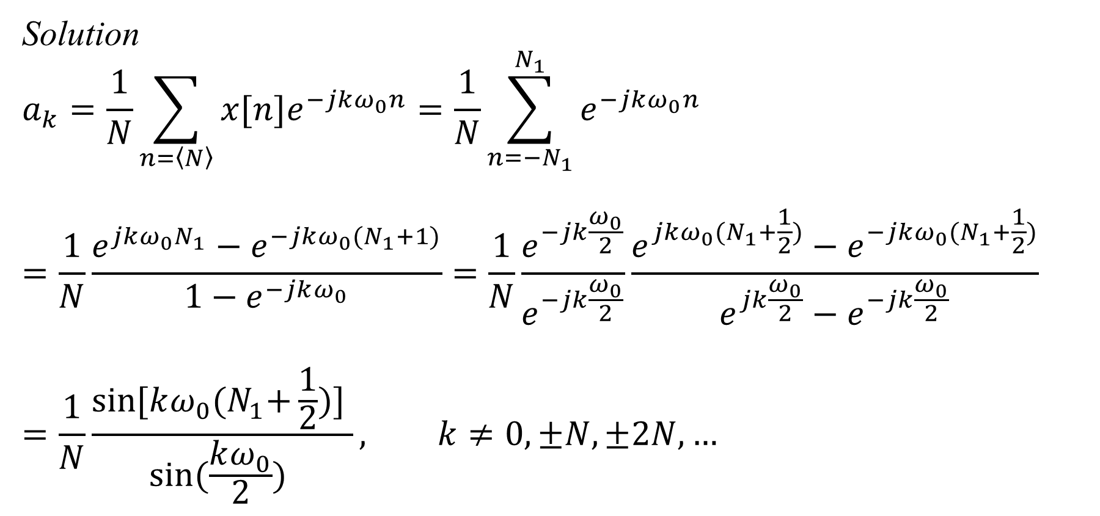
Determination of Fourier Series Coefficient
Solution
$$a_{k}=\frac{1}{N}\sum_{n=\left\langle N\right\rangle }{x[n]e^{−jkω_{0}n}}=\frac{1}{N}\sum_{n=−N_{1}}^{N_{1}}{e^{−jkω_{0}n}}$$
$$=\frac{1}{N}\frac{e^{jkω_{0}N_{1}}−e^{−jkω_{0}{(N}_{1}+1)}}{1−e^{−jkω_{0}}}=\frac{1}{N}\frac{e^{−jk\frac{ω_{0}}{2}}}{e^{−jk\frac{ω_{0}}{2}}}\frac{e^{jkω_{0}{(N}_{1}+\frac{1}{2})}−e^{−jkω_{0}{(N}_{1}+\frac{1}{2})}}{e^{jk\frac{ω_{0}}{2}}−e^{−jk\frac{ω_{0}}{2}}}$$
$$=\frac{1}{N}\frac{sin⁡[kω_{0}{(N}_{1}+\frac{1}{2})] }{sin⁡(\frac{kω_{0}}{2}) }, k≠0,±N,±2N, …$$

Slide 23

Determination of Fourier Series Coefficient
Solution
For $k=0,±N,±2N, …$ :
$$a_{k}=\frac{1}{N}\sum_{n=\left\langle N\right\rangle }{x[n]e^{−jkω_{0}n}}=\frac{1}{N}\sum_{n=−N_{1}}^{N_{1}}{e^{−jkω_{0}n}}=\frac{2N_{1}+1}{N}$$

Slide 24
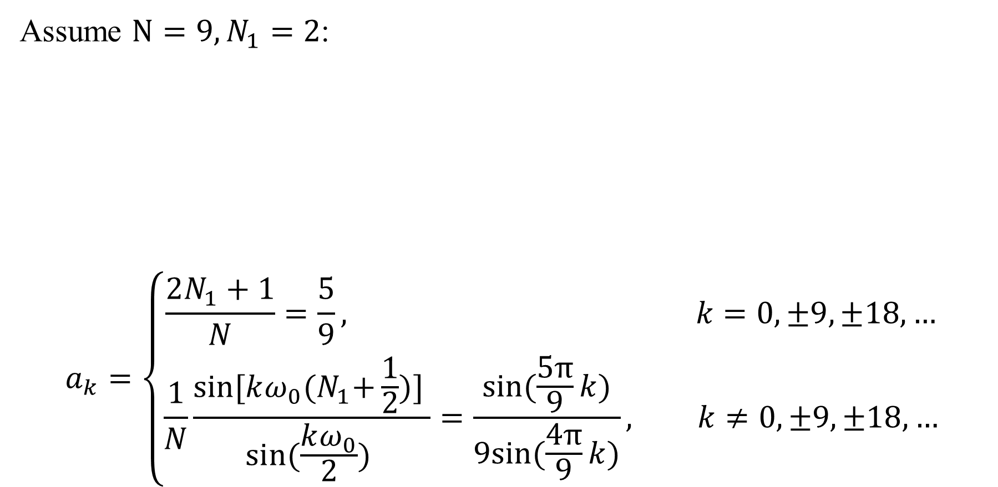
Determination of Fourier Series Coefficient
Assume $N=9, N_{1}=2$:
$$a_{k}=\left\{\begin{aligned}\frac{2N_{1}+1}{N}=\frac{5}{9}, k=0,±9,±18, … \\ \frac{1}{N}\frac{sin⁡[kω_{0}{(N}_{1}+\frac{1}{2})] }{sin⁡(\frac{kω_{0}}{2}) }=\frac{sin⁡(\frac{5π}{9}k)}{9sin⁡(\frac{4π}{9}k)}, k≠0,±9,±18, …\end{aligned}\right.$$

Slide 25
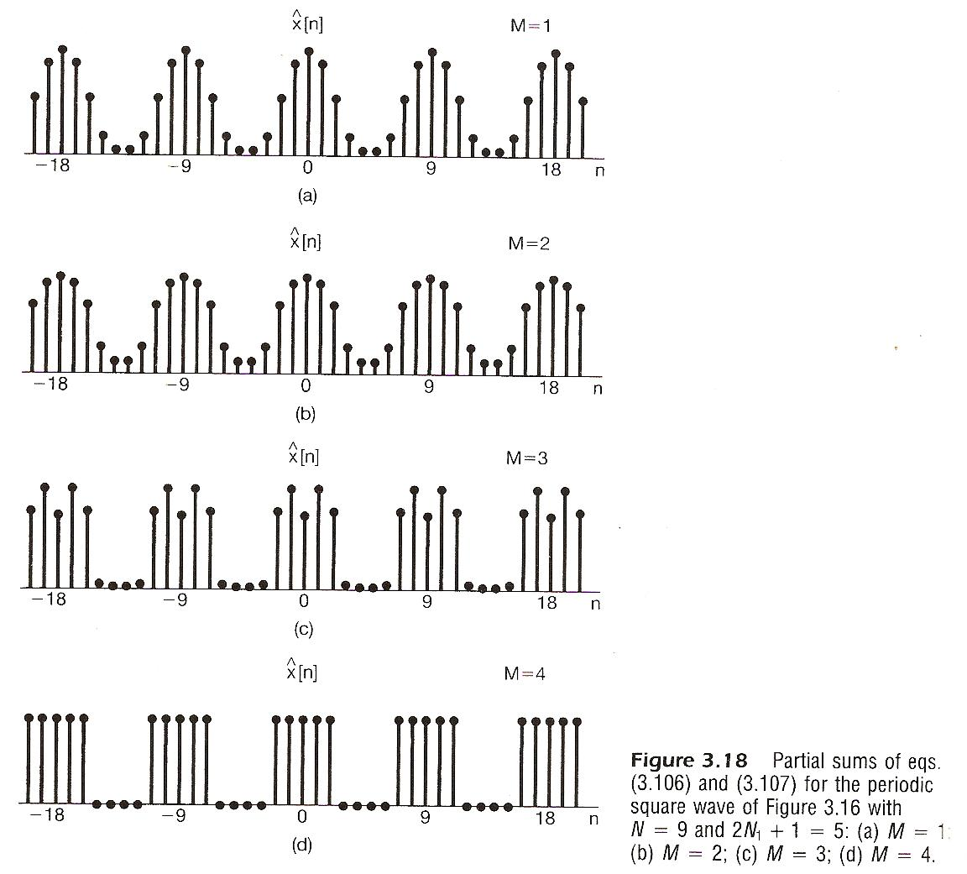

Determination of Fourier Series Coefficient
Compute the partial sum $\hat{x}[n]$ for $N=9, N_{1}=2$as follows:
$$\hat{x}\left[n\right]=\sum_{k=−M}^{M}{a_{k}e^{jkω_{0}n}}$$

Slide 26
Outline: Lecture 7: Fourier Series of Discrete-time Signals
Discrete Time Fourier Series
Fourier Series Representation
Determination of Fourier Series Coefficient
Fourier Series Properties
Application Example
System Characterization
Filtering

Slide 27

Fourier Series Properties
The following notation is used to indicate a signal, $x[n]$, can be represented by Fourier series with the coefficients, $a_{k}$.
$$x[n]\underset{↔}{FS}a_{k}$$

Slide 28
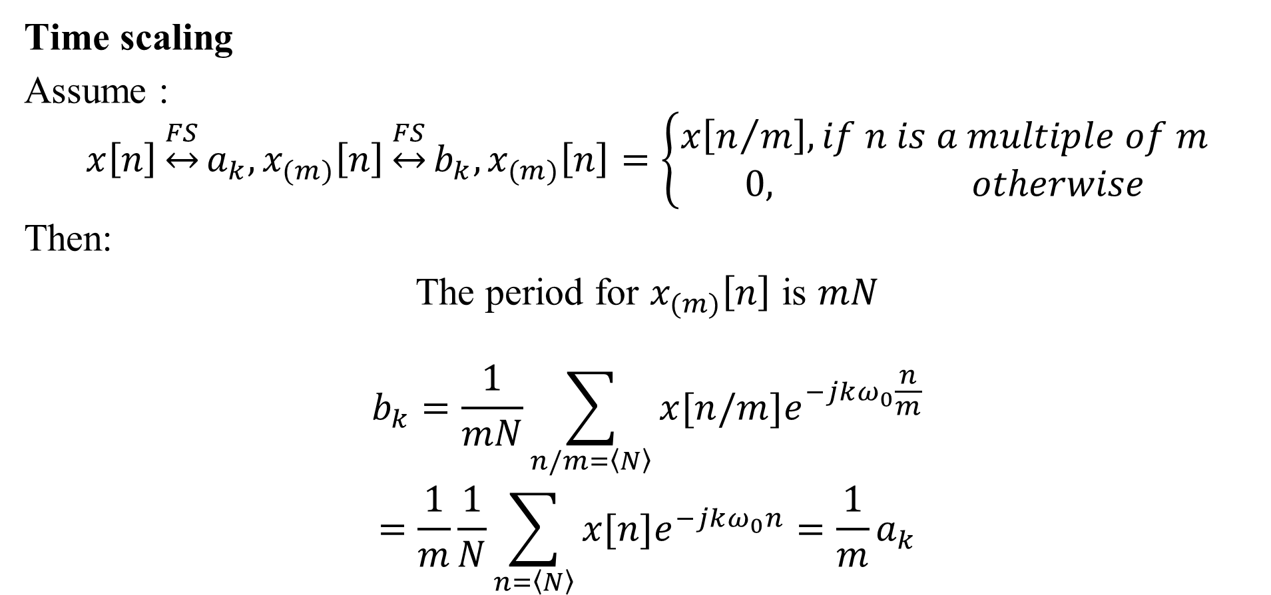
Fourier Series Properties
Time scaling
Assume :
$$x\left[n\right]\underset{↔}{FS}a_{k},x_{(m)}\left[n\right]\underset{↔}{FS}b_{k},x_{(m)}\left[n\right]=\left\{\begin{aligned}x\left[n/m\right], if n is a multiple of m \\ 0, otherwise\end{aligned}\right.$$
Then:
The period for $x_{(m)}\left[n\right]$ is $mN$
$$b_{k}=\frac{1}{mN}\sum_{n/m=\left\langle N\right\rangle }{x[n/m]e^{−jkω_{0}\frac{n}{m}}}$$
$$=\frac{1}{m}\frac{1}{N}\sum_{n=\left\langle N\right\rangle }{x[n]e^{−jkω_{0}n}}=\frac{1}{m}a_{k}$$

Slide 29

Fourier Series Properties
Multiplication
Assume :
$$x[n]\underset{↔}{FS}a_{k}, y[n]\underset{↔}{FS}b_{k}\text{,}$$
Then:
$$x\left(t\right)y\left(t\right)\underset{↔}{FS}d_{k}=\sum_{l=\left\langle N\right\rangle }{a_{l}b_{k−l}}$$

Slide 30

Fourier Series Properties
First difference
$$x\left[n\right]\underset{↔}{FS}a_{k}, x\left[n\right]−x[n−1]\underset{↔}{FS}d_{k}$$
Based on time shift property:
$$x\left[n−1\right]\underset{↔}{FS}a_{k}e^{−jkω_{0}}$$
Based on linearity property:
$$x\left[n\right]−x\left[n−1\right]\underset{↔}{FS}d_{k}=a_{k}−a_{k}e^{−jkω_{0}}$$

Slide 31

Fourier Series Properties
Parseval’s relation
The average power of a function in a period is equal to the sum of the square (power) of its Fourier series coefficients.
$$\frac{1}{N}\sum_{k=\left\langle N\right\rangle }{{|x[n]|}^{2}}=\sum_{k=\left\langle N\right\rangle }{{|a_{k}|}^{2}}$$

Slide 32
Outline: Lecture 8: Fourier Series of Discrete-time Signals
Discrete Time Fourier Series
Fourier Series Representation
Determination of Fourier Series Coefficient
Fourier Series Properties
Application Example
System Characterization
Filtering

Slide 33




System Characterization
Assume $x\left(t\right)=e^{jωt}, x\left[n\right]=e^{jωn}$
$$y\left(t\right)=e^{jωt}\int_{−∞}^{∞}{h\left(τ\right)e^{−jωτ}dτ}=e^{jωt}H\left(jω\right)=x\left(t\right).H\left(jω\right)$$
$$y\left[n\right]=e^{jωn}\sum_{l=−∞}^{∞}{h\left[l\right]e^{−jωl}}=e^{jωn}H\left(e^{jω}\right)=x[n].H\left(e^{jω}\right)$$
$$h\left(t\right), h[n]$$
$$x\left(t\right), x[n]$$
$$y\left(t\right), y[n]$$
LTI

Slide 34
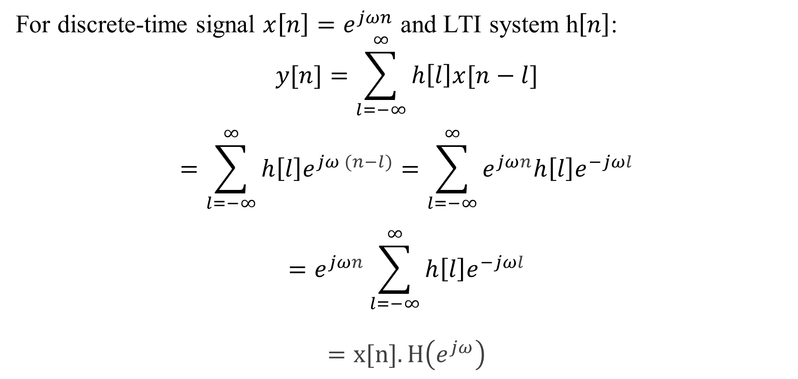
System Characterization
For discrete-time signal $x\left[n\right]=e^{jωn}$ and LTI system h$\left[n\right]$:
$$y[n]=\sum_{l=−∞}^{∞}{h\left[l\right]x[n−l]}$$
$$=\sum_{l=−∞}^{∞}{h\left[l\right]e^{jω (n−l)}}=\sum_{l=−∞}^{∞}{e^{jωn}h\left[l\right]e^{−jωl}}$$
$$=e^{jωn}\sum_{l=−∞}^{∞}{h\left[l\right]e^{−jωl}}$$
$$=x[n].H\left(e^{jω}\right)$$

Slide 35
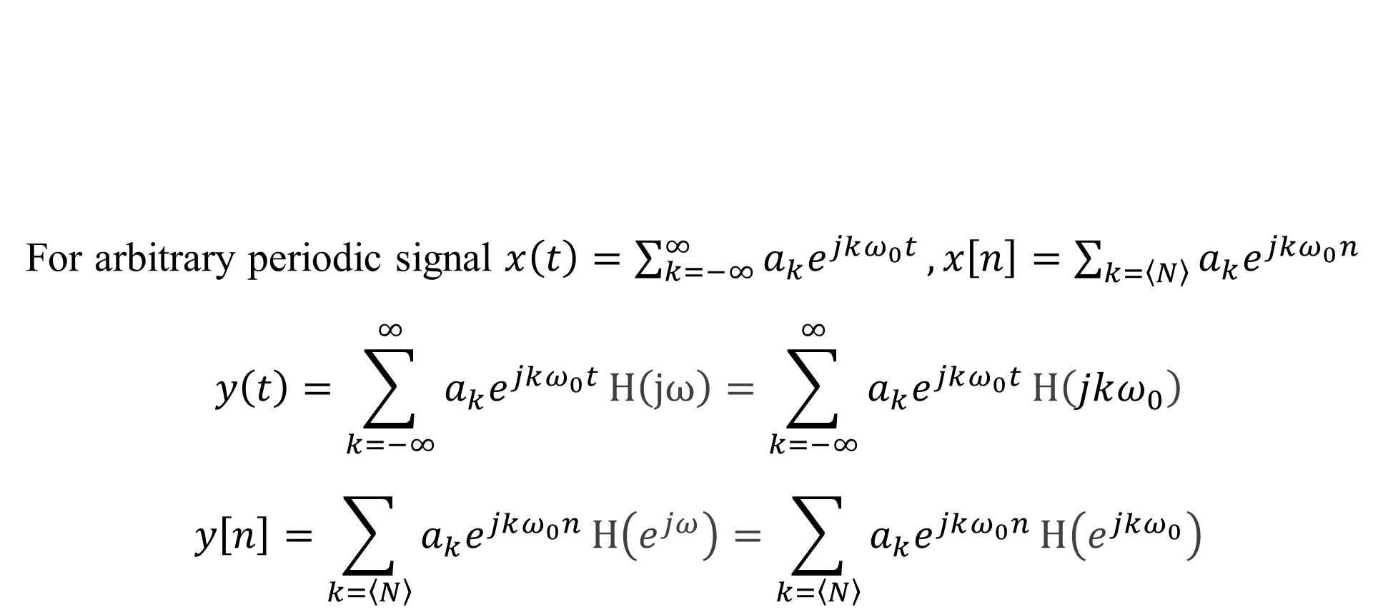
System Characterization
For arbitrary periodic signal $x\left(t\right)=\sum_{k=−∞}^{∞}{a_{k}e^{jkω_{0}t}}, x\left[n\right]=\sum_{k=\left\langle N\right\rangle }{a_{k}e^{jkω_{0}n}}$
$$y\left(t\right)=\sum_{k=−∞}^{∞}{a_{k}e^{jkω_{0}t}}H\left(jω\right)=\sum_{k=−∞}^{∞}{a_{k}e^{jkω_{0}t}}H\left(jkω_{0}\right)$$
$$y\left[n\right]=\sum_{k=\left\langle N\right\rangle }{a_{k}e^{jkω_{0}n}}H\left(e^{jω}\right)=\sum_{k=\left\langle N\right\rangle }{a_{k}e^{jkω_{0}n}}H\left(e^{jkω_{0}}\right)$$
$$h\left(t\right), h[n]$$
$$x\left(t\right), x[n]$$
$$y\left(t\right), y[n]$$
LTI

Slide 36
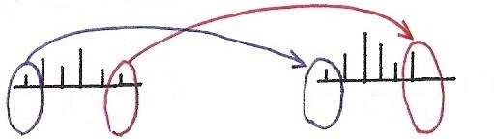

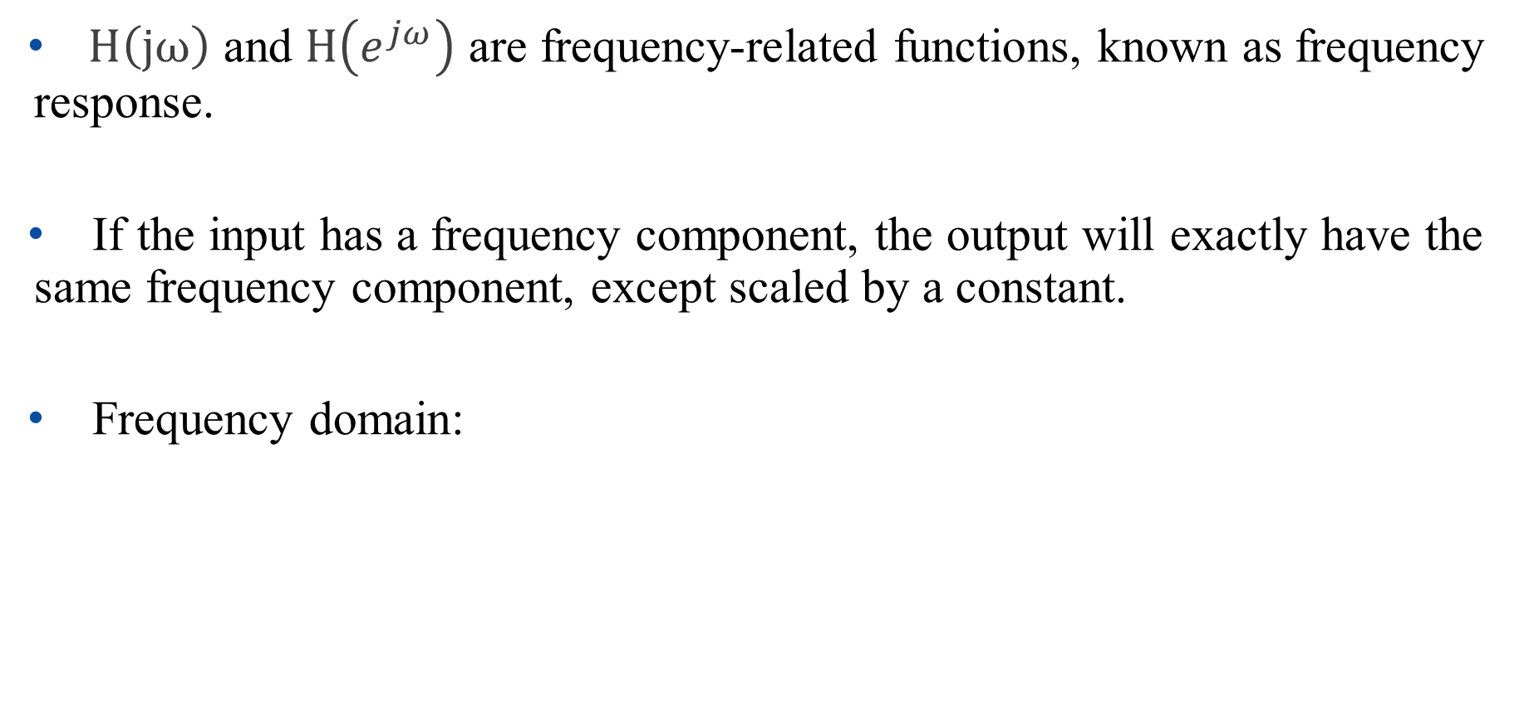







System Characterization
$H\left(jω\right)$ and $H\left(e^{jω}\right)$ are frequency-related functions, known as frequency response.
If the input has a frequency component, the output will exactly have the same frequency component, except scaled by a constant.
Frequency domain:
$$ω$$
$$ω$$
$$ω_{1}$$
$$ω_{3}$$
$$ω_{5}$$
$$ω_{1}$$
$$ω_{3}$$
$$ω_{5}$$

Slide 37
Outline: Lecture 7: Fourier Series of Discrete-time Signals
Discrete Time Fourier Series
Fourier Series Representation
Determination of Fourier Series Coefficient
Fourier Series Properties
Application Example
System Characterization
Filtering

Slide 38
Filtering
Modifying the amplitude/phase of the different frequency components in a signal, including eliminating some frequency components entirely.
frequency-shaping filter （频率成形滤波器）
frequency-selective filter （频率选择滤波器）

Slide 39
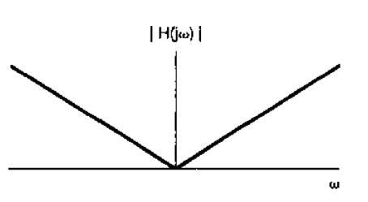

Filtering
Example: frequency-shaping filter
$$H\left(jω\right)=jω$$
Amplify high frequency components
Amplitude:

Slide 40
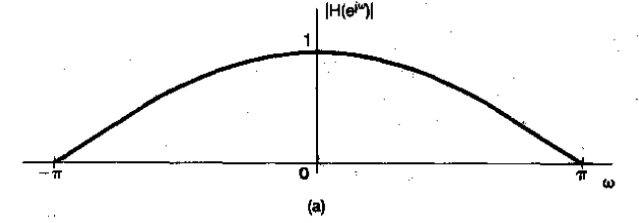

Filtering
Example: frequency-shaping filter
$$h\left[n\right]=\frac{1}{2}[δ\left[n\right]+δ[n−1]]$$
$$H\left(e^{jω}\right)=\sum_{n=−∞}^{∞}{\frac{1}{2}\left[δ\left[n\right]+δ\left[n−1\right]\right]e^{−jωn}=\frac{1}{2}\left[1+e^{−jω}\right]}=e^{{−jω}/2}cos⁡(\frac{ω}{2})$$
Amplitude:
Compress high frequency components

Slide 41
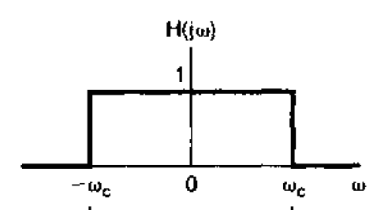

Filtering
Example: frequency-selective filter
Ideal low-pass filter
$$H\left(jω\right)=\left\{\begin{aligned}1, |ω|≤ω_{c} \\ 0, \left|ω\right|>ω_{c}\end{aligned}\right.$$

Slide 42
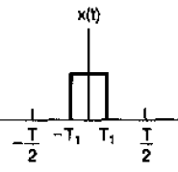







Filtering
Example: frequency-selective filter
Ideal low-pass filter
$$x\left(t\right)$$
$$y\left(t\right)=?$$
LTI
$$h\left(t\right)$$
$$−\frac{T}{4}$$
$$\frac{T}{4}$$
$$\frac{5π}{T}$$
$$−\frac{5π}{T}$$
π

Slide 43
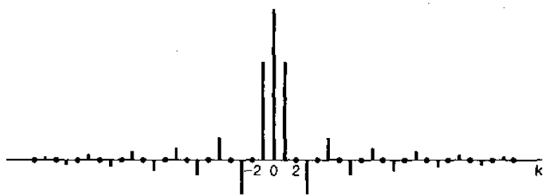






Filtering
Example: frequency-selective filter
Ideal low-pass filter
$$x\left(t\right)$$
$$y\left(t\right)=?$$
LTI
$$h\left(t\right)$$
$$a_{k}=\left\{\begin{aligned}\frac{sin⁡(k\frac{π}{2}) }{kπ}, k≠0 \\ \frac{1}{2}, k=0\end{aligned}\right.$$
$$a_{k}$$
$$ω=−\frac{4π}{T}$$
$$ω=\frac{4π}{T}$$
$$−\frac{5π}{T}$$
$$\frac{5π}{T}$$

Slide 44


Filtering
Example: frequency-selective filter
Ideal low-pass filter
$$a_{k}$$
$$x\left(t\right)$$
$$y\left(t\right)$$
LTI
$$h\left(t\right)$$
$$a_{k}=\left\{\begin{aligned}\frac{sin⁡(k\frac{π}{2}) }{kπ}, k≠0 \\ \frac{1}{2}, k=0\end{aligned}\right.$$
$$a_{k}$$
$$ω=−\frac{4π}{T}$$
$$ω=\frac{4π}{T}$$
$$−\frac{5π}{T}$$
$$\frac{5π}{T}$$

Slide 45









Filtering
Example: frequency-selective filter
Ideal low-pass filter
$$x\left(t\right)$$
$$y\left(t\right)$$
LTI
$$h\left(t\right)$$
$$a_{−2}=0$$
$$a_{−1}=1/π$$
$$a_{0}=1/2$$
$$a_{1}=1/π$$
$$a_{2}=0$$
$$a_{k}$$
$$−\frac{T}{4}$$
$$\frac{T}{4}$$
$$−\frac{T}{2}$$
$$−\frac{T}{4}$$
0
$$\frac{T}{4}$$
$$\frac{T}{2}$$

Slide 46



Filtering
Example: frequency-selective filter
Ideal filters (continuous-time signal)
(c)
(a)
(b)
Low-pass filter
High-pass filter
Band-pass filter

Slide 47



Filtering
Example: frequency-selective filter
Ideal filters (discrete-time signal)
(c)
(a)
(b)
Low-pass filter
High-pass filter
Band-pass filter

Slide 48
Thank you for your listening!

